Slide 1
Week 2: Random Implementation
Bose and Dao

Slide 2
Deliverables
Identify correlation between portfolio composition, selection of stocks and the number of stocks with returns
Find most profitable strategy with random parameters
Selection metric comparison
Identify random benchmarks
Streamline backtesting architecture

Slide 3
Parameters
Initial Budget: $10,000
Strategies
Buy and hold (benchmark)
Random number of stocks
Random stock selection
Random portfolio composition
Random dollar cost averaging
Metrics
Complete random
Long-term investing

Slide 4
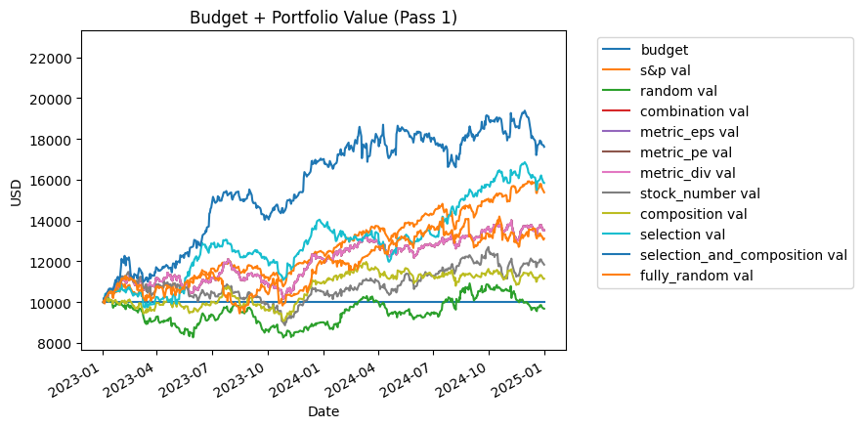
Strategy Returns

Slide 5
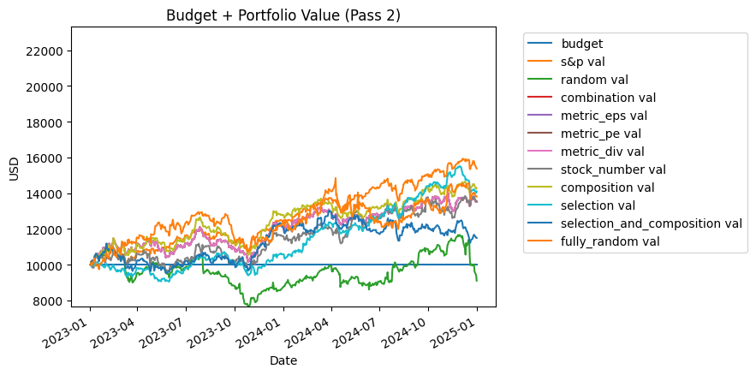
Strategy Returns

Slide 6
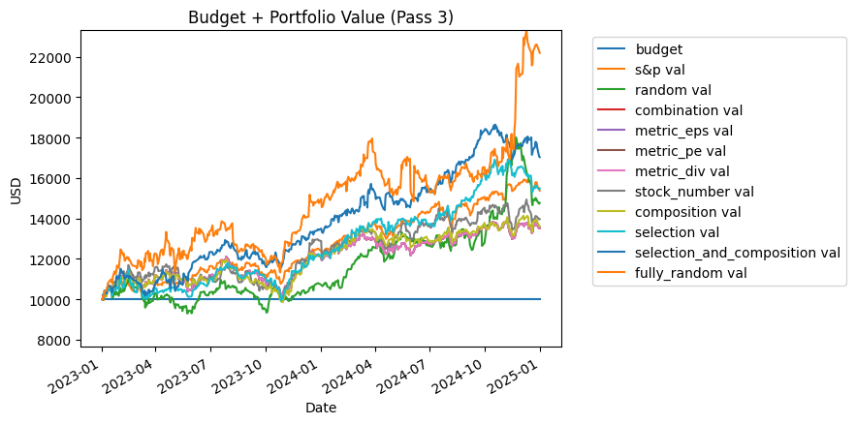
Strategy Returns

Slide 7
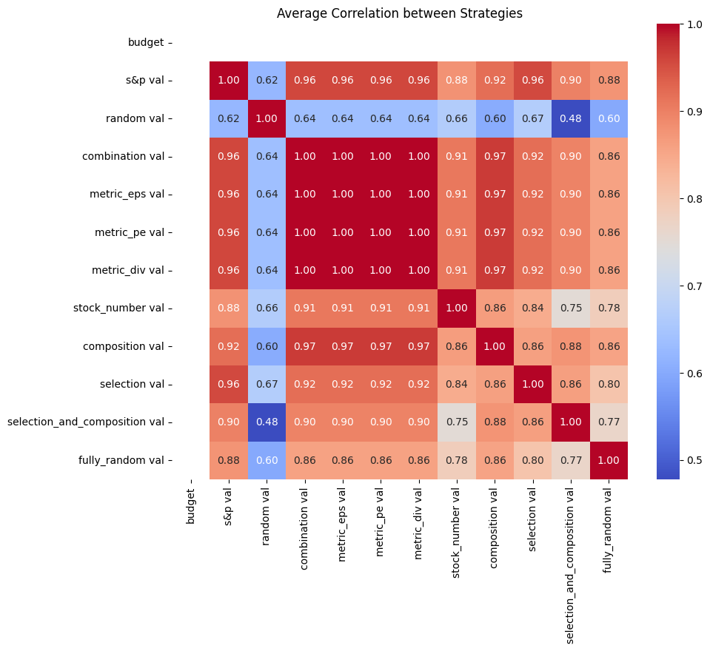
Parameter correlation
High correlation between strategies
More thorough controls may be required
Continuous analogs

Slide 8
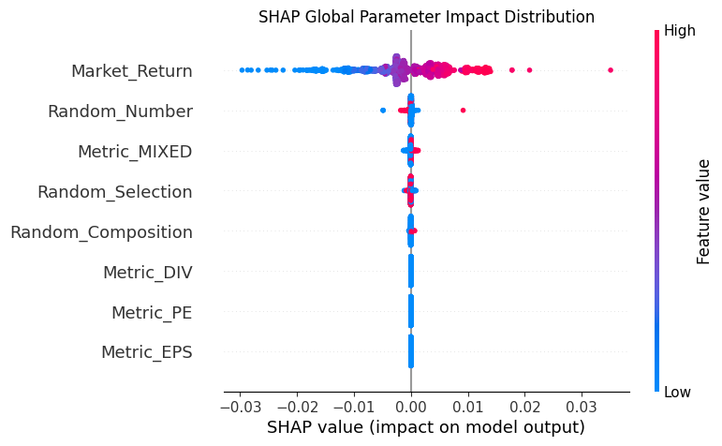
Naive ranking
Market return = .005480
Random number = .000116
Metric mixed = .000079
Random selection = .000058
Random composition = .000038

Slide 9
Final Notes
Random strategy causal analysis (independence?)
Quantum portfolio composition (should we stick with composition?)
Future approach to work and presentation (how should we test things independently?)
ID card access

Slide 10
Notes
Fix the quantity. N = 1
If you can’t buy 10, then don’t buy
EPS, dividend, PE and we want to see which metric is the most informative
After we find the most important metric, then randomize the quantity of stocks
Find survey of portfolio optimization to read. Then we can find newer methods later
Bandit methods(a form of reinforcement learning)
Recommendation paper that Biplav will send. Papers at the intersection of learning and search
Only really consider papers that we can replicate and implement ourselves.
Update all of the lines. Add punchlines and also make the baseline in black and dotted lines.

